Slide 1
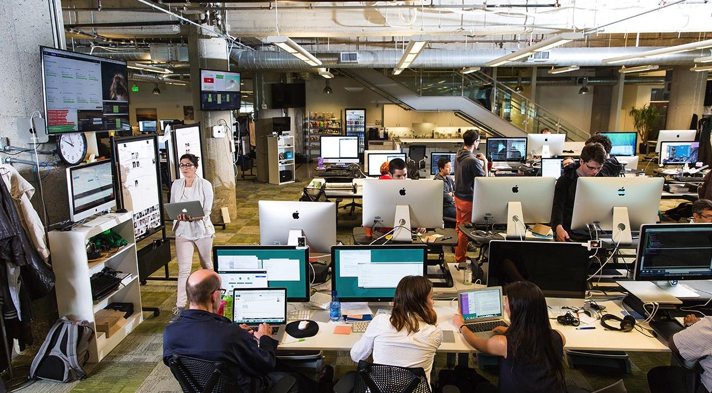

Building the world’s most successful software businesses

Slide 2
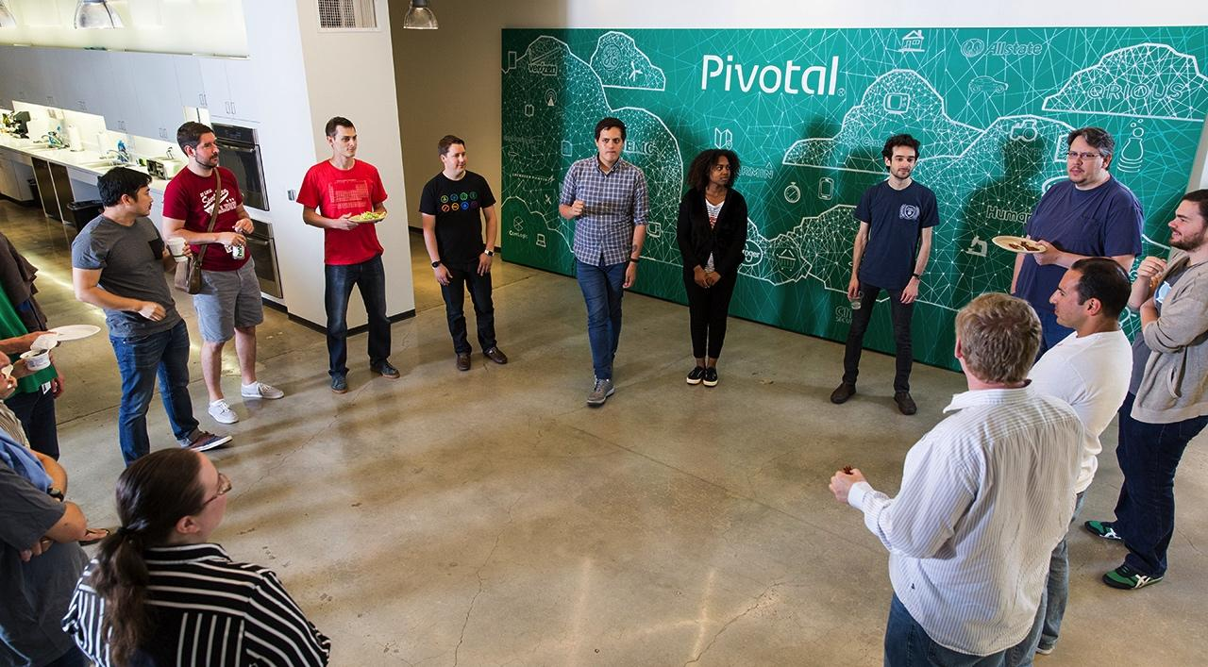
Our mission is to transform how the world builds software

Slide 3















1990
Discover
An agile, rapid iteration, test-driven approach to software development
2000
Implement
New methodologies to influence software development culture of Silicon Valley’s most influential internet companies
2013
Accelerate
The transformation of the world’s largest companies with modern software development methods and cloud platform
2016
Transform
The world’s largest companies into cloud native software companies
Rob Mee
Paul Maritz
Scott Yara
Bill Cook

Slide 4










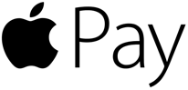

Slide 5

Lightening fast and agile
These software companies are capable of releasing new features:
In minutes
Multiple times a day
At enormous scale
Around the world

Slide 6

Hope of transformation
“If you went to bed last night as an industrial company, you’re going to wake up a software and analytics company.”
Jeff Immelt
CEO, General Electric
Source: User Summit (2014)

Slide 7


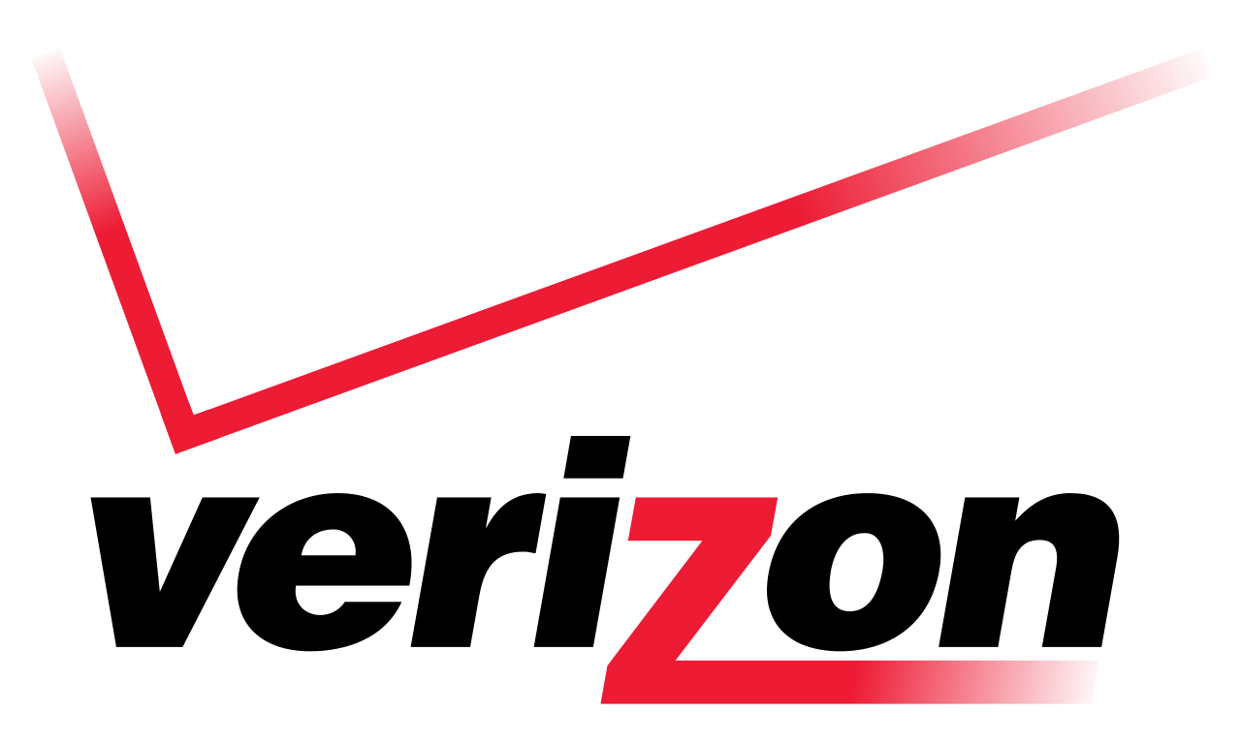
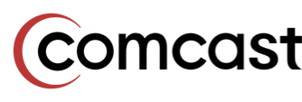


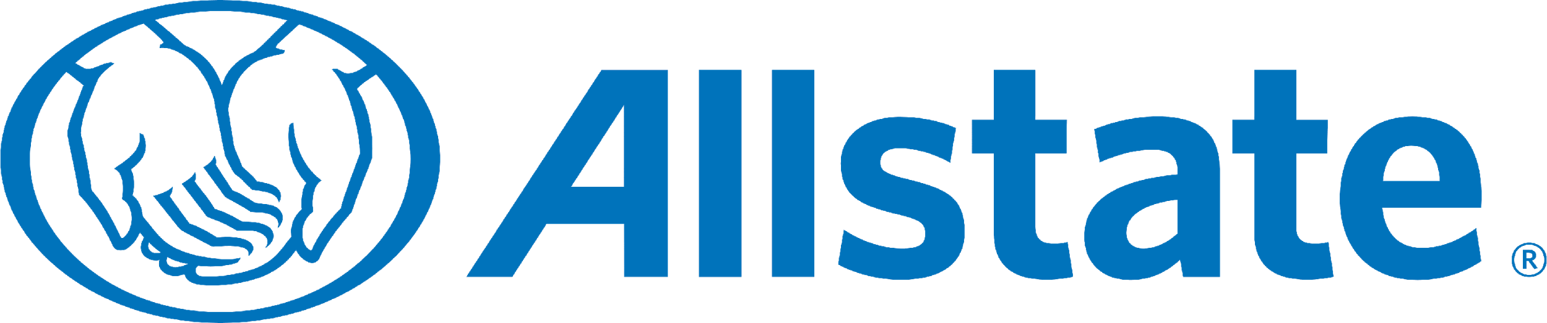




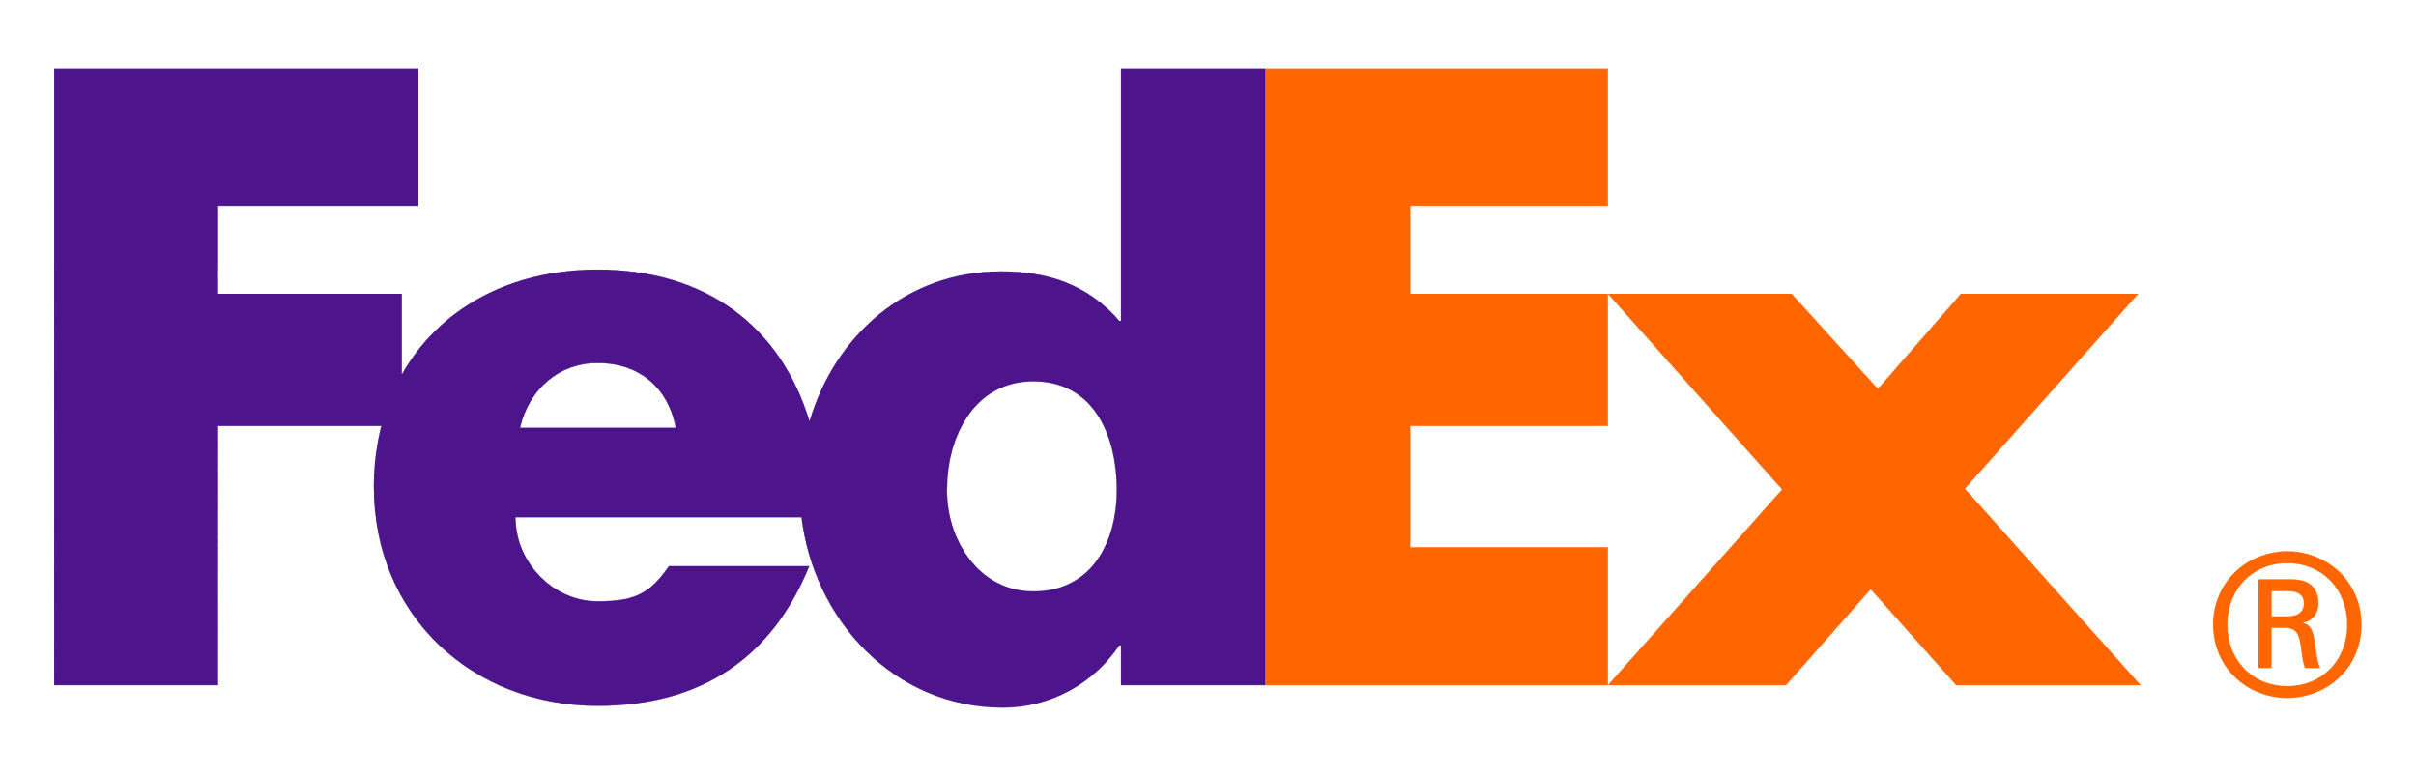

Slide 8

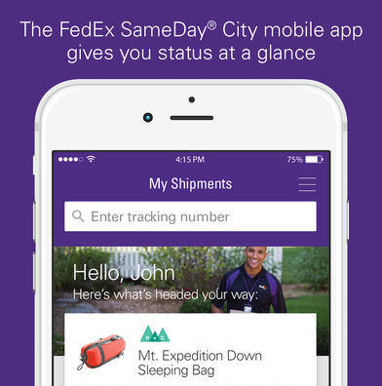
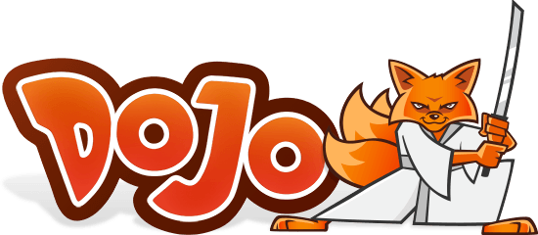


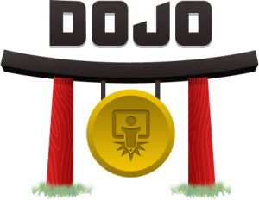



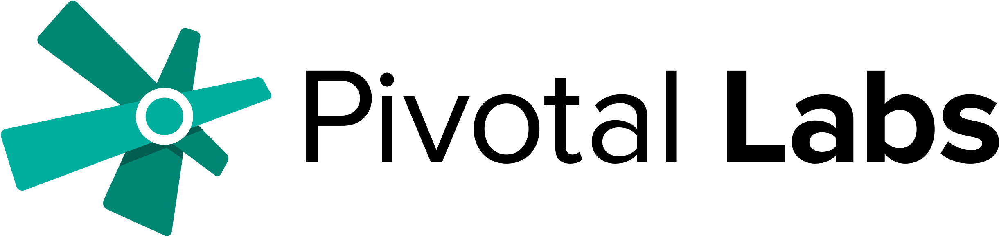
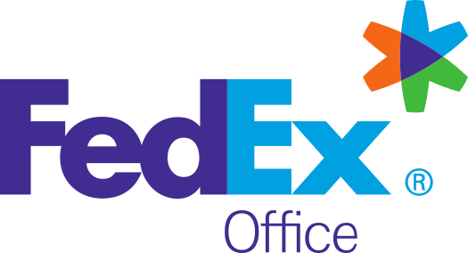
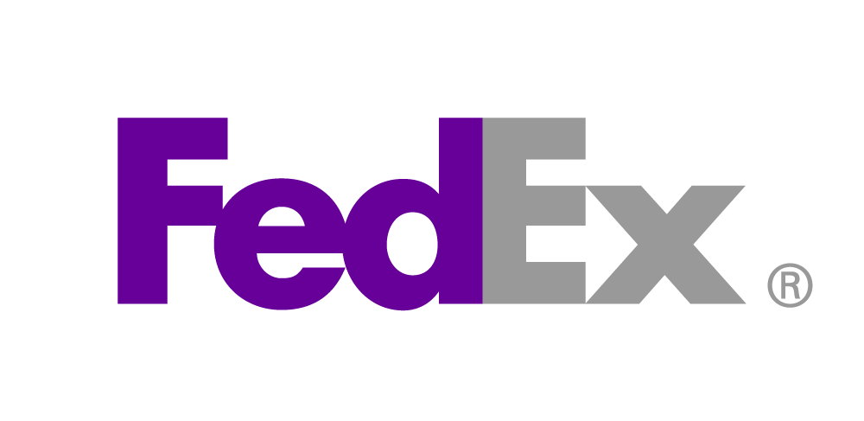

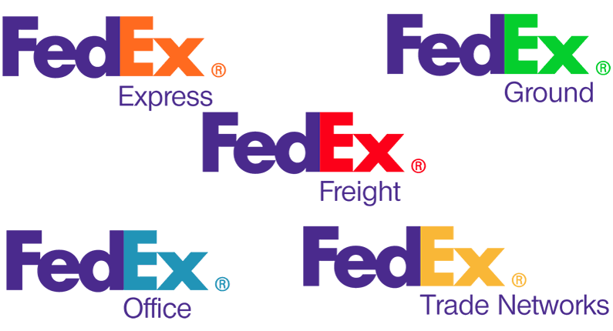


2014
Discover
2015
Implement
2016
Accelerate
2017
Transform

Slide 9

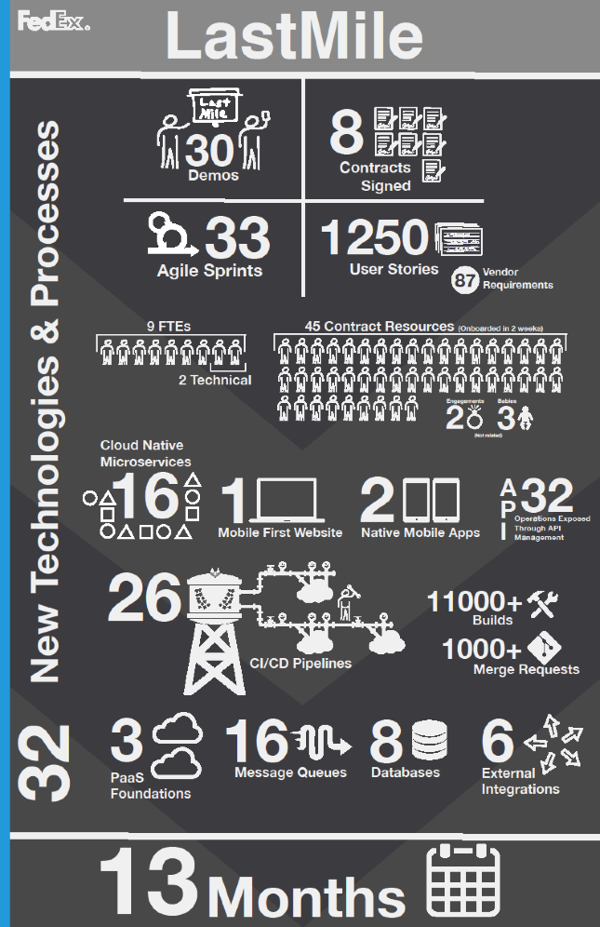

CONTINUOUSLY DELIVER GREAT SOFTWARE
Deliver business results at high velocity by becoming a cloud native software company.
Idea
Learn
Code
Test
Continuous Integration
Deploy
Accept
Build
Credit: Sean Williams, Chris Bochman, Drew Terrell
Notes:
Audience already know they wanna build great sw
This slide speaks to CI/CD + the resiliency afforded by PCF as the answer
Objective = Of course! This sounds fantastic!
OLD NOTES ….
* Stats from The Case for Continuous Delivery by Jez Humble, Feb 2014
So why continuous delivery?
Pivotal CF is at the heart of the solution we’ve been talking about. If a customer is looking to build a next-gen PaaS it is ABSOLUTELY the best platform to do this from an automation, value and openness perspective. PaaS and Pivotal CF on their own offer tremendous operational benefits.
It’s also important to know that you CAN do a lot of the fancy automation I just talked through using a traditional VMware IaaS M&O stack and tools like Puppet or Chef. This direction is less “turn---key” for sure but is recommended path when modernizing to get maximum efficiency from 2nd platform systems.
But let’s talk about Continuous Delivery PLUS Cloud Foundry
<CLICK>
Like I said, surrounding PaaS is a set of integrated tools that automate the SDLC
<CLICK>
When combined these things improve time to market --- you can literally ship code 30 times faster
<CLICK>
Higher quality – 50% fewer failed deployments and the ability to restore services 12x faster
<CLICK>
Reduced cost – 90% lower operational costs thanks to significantly lower headcount requirements
<CLICK>
And finally it delivers early ROI – by getting code out the door sooner and updating more often --- these initiatives tend to pay for themselves very quickly

Slide 10
What’s Next for FedEx?

Slide 11
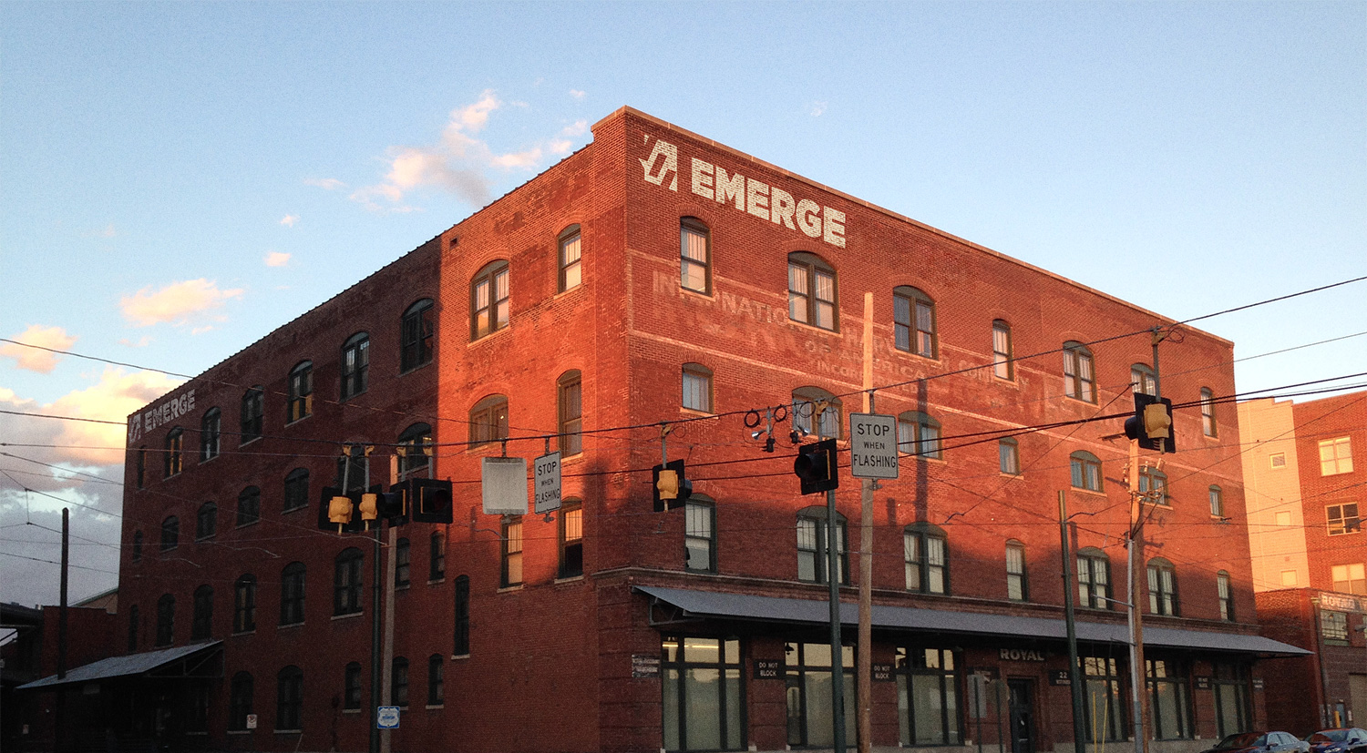



Cloud Dojo - Accelerate, Agile Everything
CLOUD-WILLING APPS (FAST)
---
OFF-SITE LOCATION
---
DEDICATED RESOURCES
---
PCF ENVIRONMENT
---
PIVOTAL RESOURCES
PAAS
INPUTS
CI/CD
AGILE
TECH OPS, DEV, SEC, Q/A
DATA SVCS
CLOUD NATIVE APPS IN PROD
---
FULLY AUTOMATED CI/CD
---
IT OPS MODEL FOR CLOUD NATIVE APPS
---
ROLES & RESPONSIBILITIES
---
CLOUD ARCHITECTURE PATTERNS
OUTPUTS
<<< CONTINUOUS LEARNING <<<

Slide 12
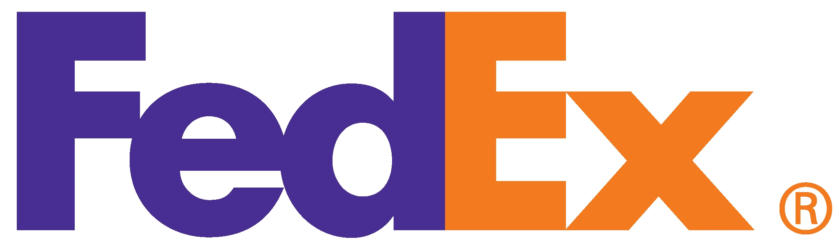
Platform Journey - An Illustration
PLAN
DEPLOY
OPERATE
REPLATFORM AND SCALE
MONTH
Apr
May-June
July-Aug
Sept-Oct
Nov-Dec
Finalize Initial Timeline
Inceptions for Replatforming Initiative; Dojo
Inception for Replatforming Initiative Wave 2
Dojo Inception
Apps Deployed; Ops Model in Place
10 to XXX Apps Running on PCF
Initial Deployments Complete to Prod
PRE-WORK
PLATFORM DOJO
OPERATIONS DOJO
Platform Services
SCALE
PRE-WORK: APP IDENTIFICATION
APPLICATION
REPLATFORMING
Target Apps: CNTY, ROSS, CAAS
Outcomes: Multiple team visibility to moving apps to platform, Cookbooks, team enablement
APPLICATION
REPLATFORMING
Milestone: Strategic Touchpoint and Planning for “Factory concept” to migrate applications at scale (Customer, Partner, etc)
Target Apps: TBD
Outcomes: Multiple team visibility to moving apps to platform, Cookbooks, team enablement
PIVOTAL LABS ENGAGEMENT (ENGINEERING, DESIGN, PRODUCT MANAGEMENT, ARCHITECTURE)
ONGOING EXPERTISE (ENGINEERING, DESIGN, PRODUCT MANAGEMENT, ARCHITECTURE)
EDUCATION (ADDITIONAL E-LEARNING OR TRAIN-THE-TRAINER)
Replatforming and COE/Dojo Buildout Approach

Slide 13





Cloud Dojo Goals
Define & Automate IT Operating Model for Cloud Native Apps
Automated CI/CD with Cloud Native Certification
Recommendations to Institutionalize the Dojo Way
Effective Collaboration for Global Teams
Meet Compliance Requirements
Notes:
Let you give you a minute to read this slide. Pause for a minute
Does this resemble our reality? Do we lack automated testing, sometimes impacting our customers’ experience? Yup, we experience this a lot right after corporate loads. How much of our time is spent waiting for someone else, just to understand that they were waiting on someone else? The process by which we get our work done involves a lot of waiting – waiting for information from customers, waiting for e-mail replies, waiting for meetings to be scheduled, etc. We also work in very protective silos – where we expect nicely packaged requests that get deposited into a work queue.
Corporate load nights are really, really long aren’t they? There are several reasons for that – couple of which are the lack of automated deployments and checkouts, environment configuration issues etc. And we have postmortems that sometimes breeds lack of trust between groups. And I know that most of you feel the pain of this tug of war between the need for stability and the need to be faster for our business.
We are slow and unreliable compared to the market today – this is not a slight to any group in operations, or development or architecture delivery – it just reflects our history, the burden of our legacy environments and applications. But our customers don’t care that we have this legacy to deal with – they are a fickle lot. They care about innovation, speed, consistency, service, and cost – and they don’t care if it is FedEx that provides the service or UPS or amazon.
So, we must take heed of the cautionary tale of Sun microsystems, and quickly adapt to the changing market, and provide speed and agility that our business needs in order to beat the competition. We need to bring it.
And to do that, we need to change not only our technologies, but also our culture and our processes – not just for the new technologies of IaaS & PaaS, but also for how we get work done for our environment today. That’s where we come in.

Slide 14


Complementary Efforts – Common Target
Initial Focus
Resiliency & CI/CD
(subset of FedEx Cloud Mins)
Desired End State
Cloud Native
(end goal for portability and additional availability gains)
All Apps
Incremental Gains
New Apps and Existing Apps with business justification
FedEx Cloud Mins
(foundational changes to support desired end state)
PH keywords - paas, hackathon

Slide 15
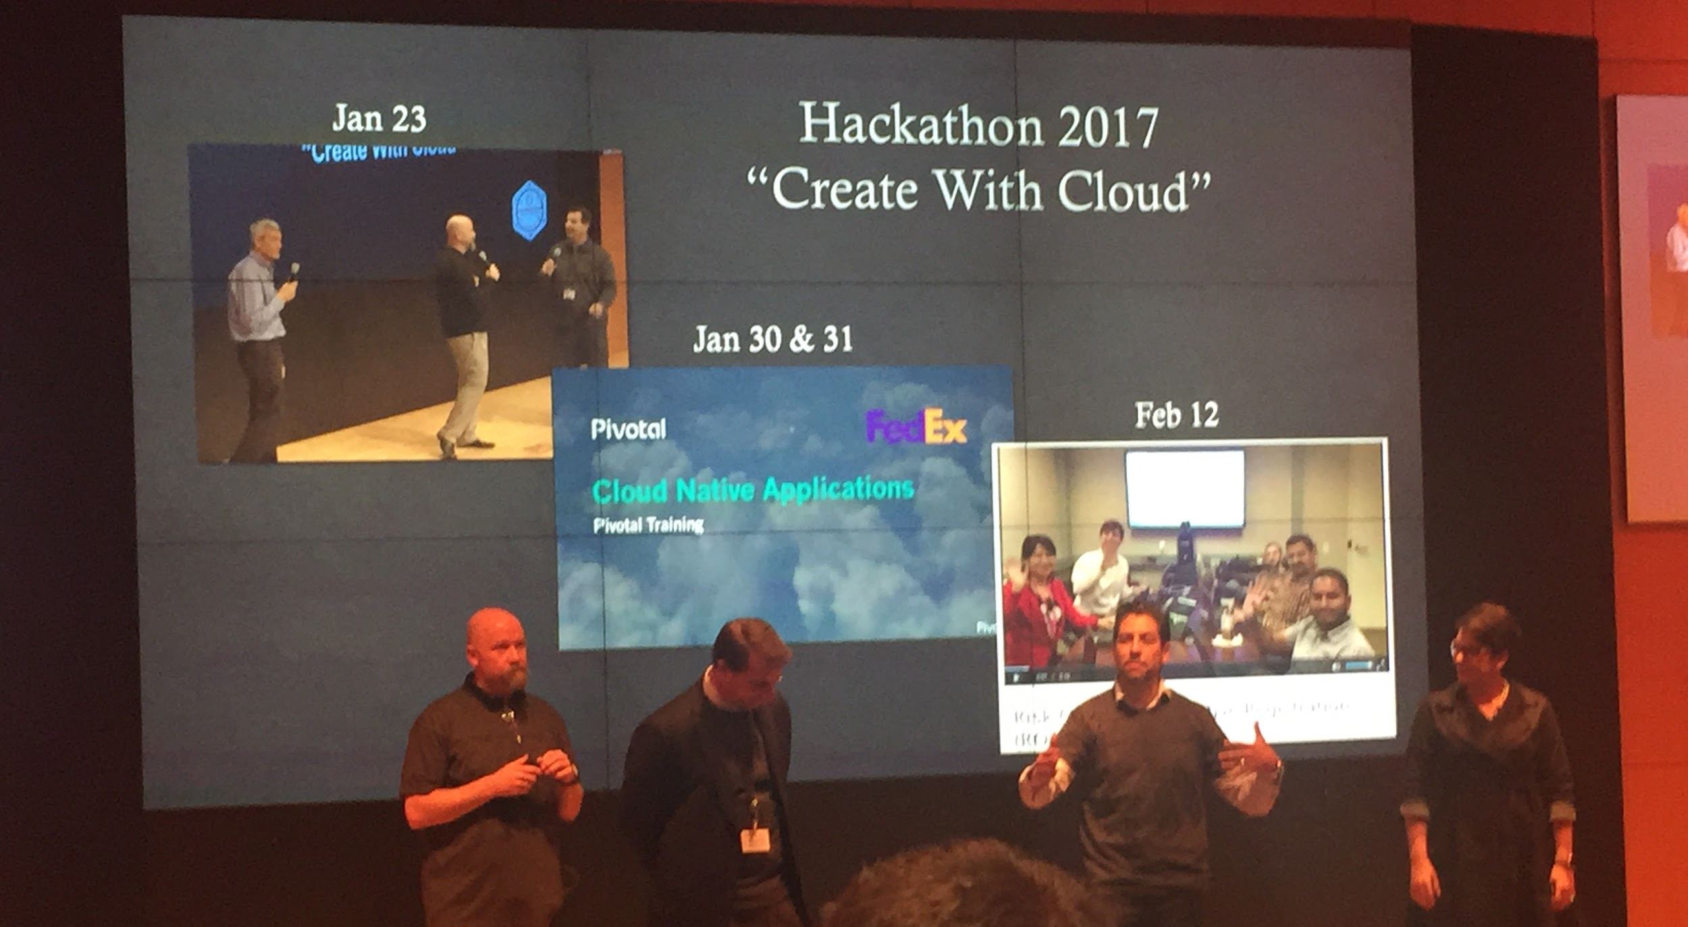

Let’s help you become a disruptor
TOGETHER

Slide 16
Appendix

Slide 17



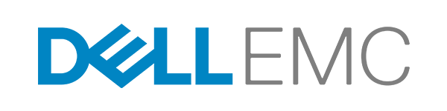

Pivotal Investors

